Slide 1
Sprint 1
PerlSquad

Slide 2
Project Requirement/Overview Clarifications:
Computer game to be used by grad students to be customized and used in the classroom
Focus is on “science literacy” and learning/reinforcing knowledge of biomes in students
User base:
Educators
(not grad) students

Slide 3
Sprint 1 Goals
Be able to tweak minigame difficulty
Implement Biome Selection
Implement Multi-Player ( No longer a specification)
Expand Options Menu
Replace scavenger hunt with hover-over info screen
Have in-game images preloaded upon start

Slide 4
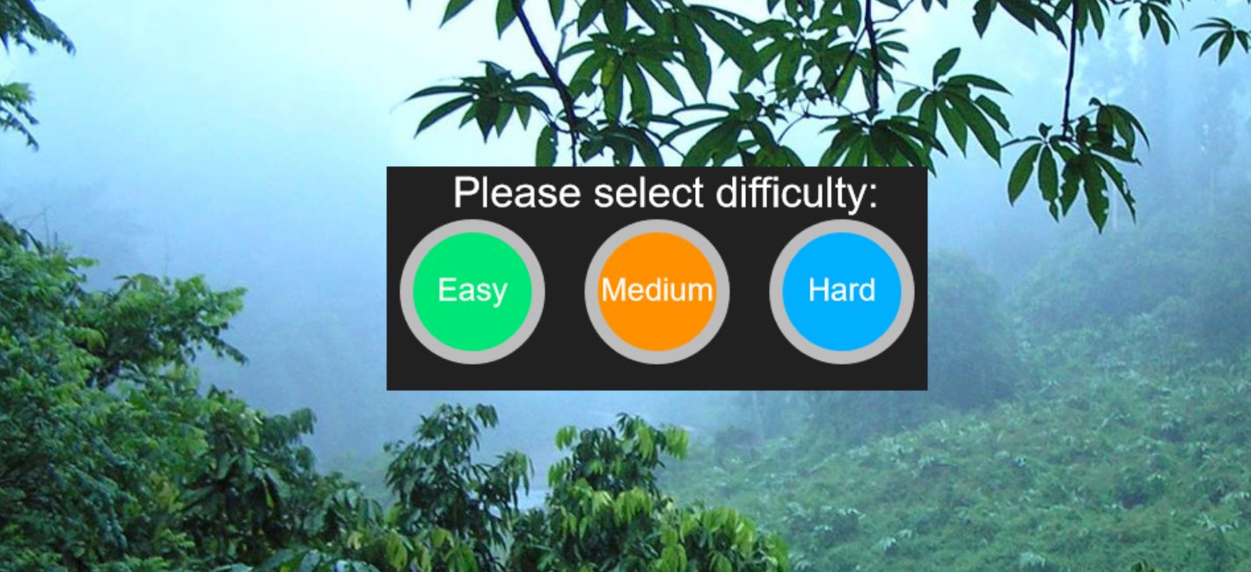
Difficulty Selection:

Slide 5
Successes & Roadblocks:
Difficulty can be adjusted before the minigame starts - currently it just modifies speed of the objects
Implementing buttons not too difficult, only issue is balancing the three settings - what is considered “hard” or “easy” to each user? (different age groups of students)
Created issue where moving object would load while on menu screen, had to play with containers to fix

Slide 6
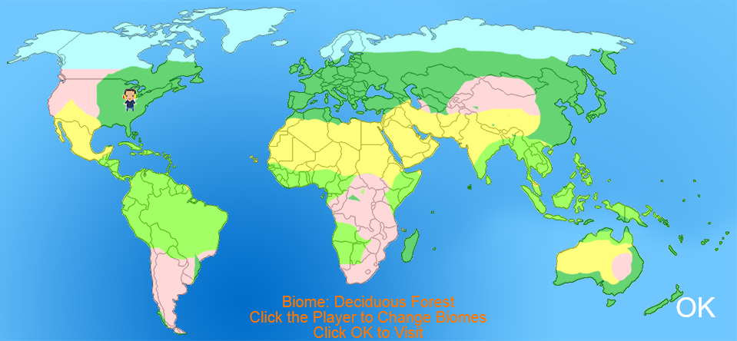
Biome Selection
Make the player walk around each of the Earth’s biomes, so the player can pick which to explore

Slide 7
Successes & Roadblocks:
Implemented a doubly linked cycle for biome traversal - makes tracking unvisited biomes, their names, and their coordinates easy.
Gave biomes realistic coordinates - had to tinker with coordinates until they looked right.
Specifications are still too loose to implement more (example: do players choose the order in which they visit the biomes, etc…)

Slide 8
Multiplayer
Worked on it during week 1, but ended up getting scrapped after a client meeting.

Slide 9
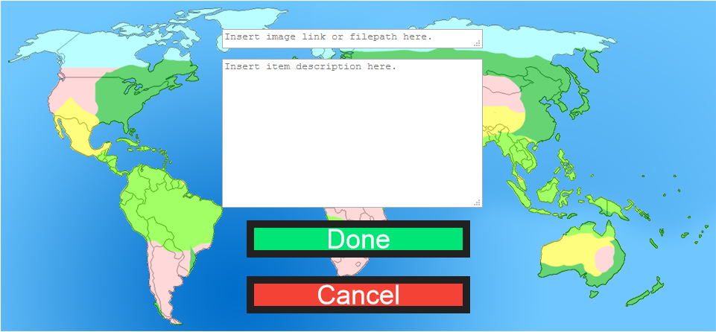
Expanded Options Menu

Slide 10
Successes & Roadblocks:
Added category selector to make adding and editing more efficient.
Added text areas for add option to provide a file path or URL and text description.
Set up Done and Cancel Buttons to confirm or cancel adding objects.
Major roadblock: Permanently adding to manifest has proven difficult - will most likely need to implement backend server to store image paths or URLs and text descriptions.

Slide 11
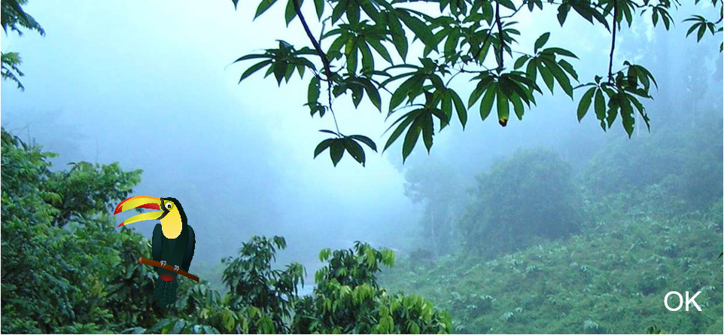
Hover-Over Info Screen

Slide 12
Successes & Roadblocks:
Replaced scavenger hunt page with Info screen - client felt it would encourage students to think for themselves and would draw more attention to biome objects.
Added hover-over events to display and hide text.

Slide 13
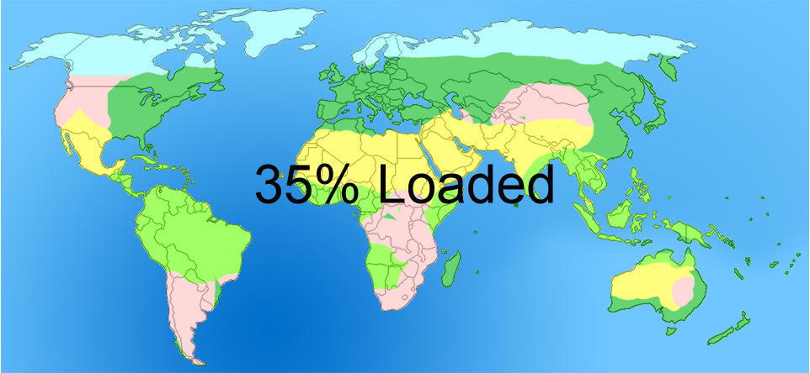
Preload Upon Start

Slide 14
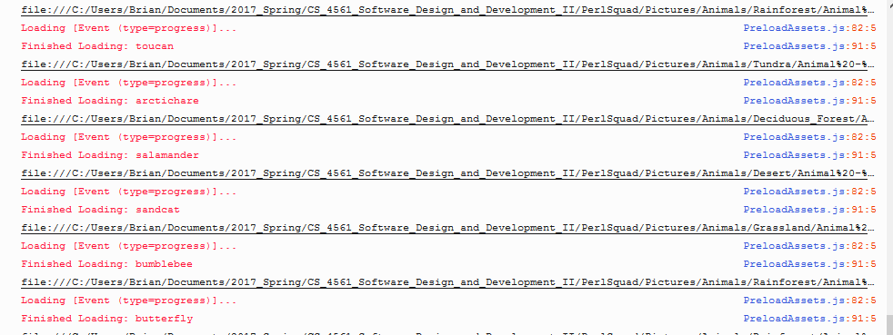
Preload Upon Start (Cont.)

Slide 15
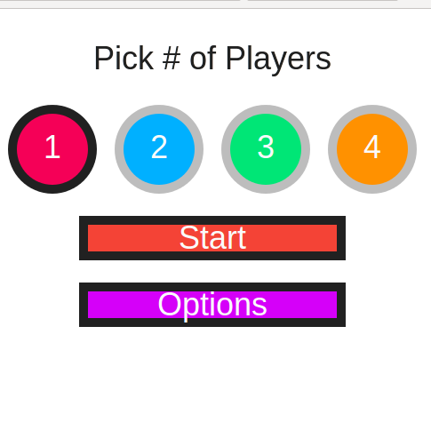
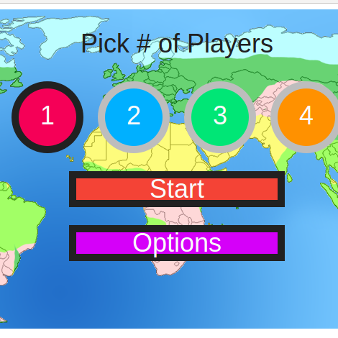
Individual Loading vs. Preload

Slide 16
Successes & Roadblocks:
Filled manifest with all current relevant image file paths
Implemented preloading with progress display included - had to turn off XHR loading and switch to tag loading in order to handle loading local files
Minor Roadblock: Image loaded via URL have to be from CORS-enabled websites - won’t be an issue in most cases - just need to specify to users supported websites

Slide 17
The Future
Implementing mini-game with additional biomes
Associate biomes with their images
Add backend for customization
Fill out hover-over info screen with more objects
Expand the game manifest to include more images and preload those images as well

